Slide 1
Self Learning Tutorial

Slide 2
Introduction
This tutorial details an analysis for correlating ADHD, prescription drug use, OCD and hallucinations.
The MIMIC III dataset was used for data
Python, pandas, sklearn, seaborn and matplotlib were used.
Kmeans and PCA (Principal Component Analysis) were used to model the data.

Slide 3
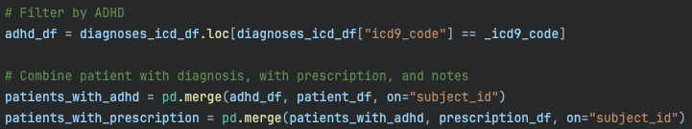
Data gathering
Using the MIMIC III database we used the following tables:
DIAGNOSES_ICD
NOTEEVENTS
PATIENTS
PRESCRIPTIONS
We then filtered all diagnoses to the icd9 code ‘31401’ (ADHD)
The patients were filtered by those who had ADHD and merged with patients who had been prescribed medication

Slide 4
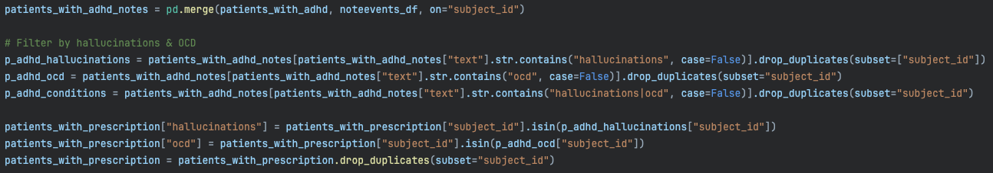
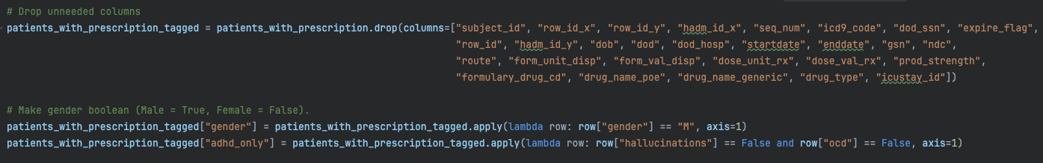
Data gathering (continued)
Using the note events, we filtered out all noted that included ocd or hallucinations.
We added the columns “hallucinations” and “ocd” to the data frame containing patients with adhd and a prescribed medication and dropped any duplicate subjects.
The data was then cleaned of all unneeded columns
Gender was made into a boolean for easier analysis later on
A new column “adhd_only” was added for any patient who has adhd but no ocd or hallucinations

Slide 5
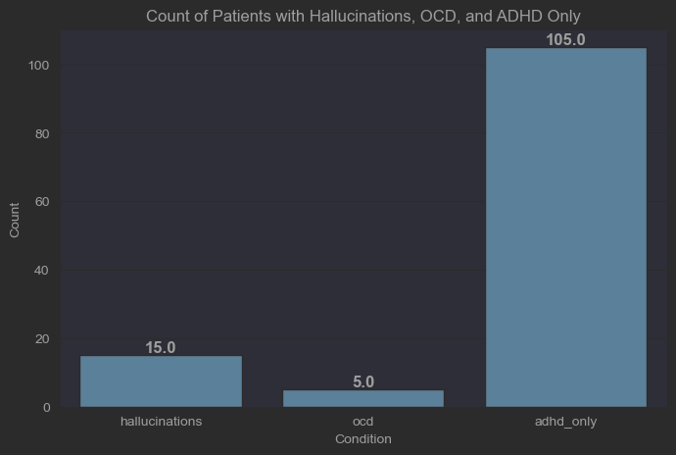
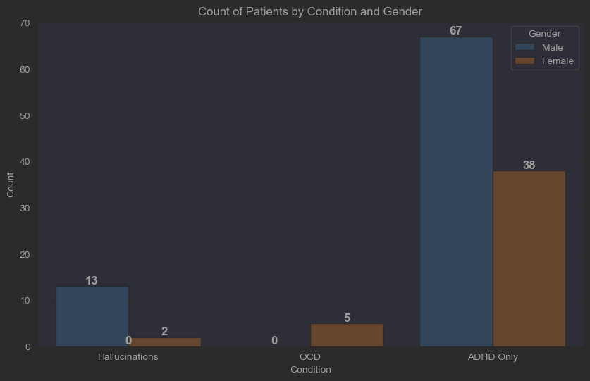
Pre-analysis
The data had no age nor any way of calculating the age of patients.
Instead we will analysed based on gender and condition.

Slide 6
Pre-analysis (Condition)
The data gathered is small (141 ADHD patients) and (19 for those who include OCD or hallucinations in their notes)
~15% of patients with ADHD reported hallucinations or OCD in their medical notes.
Surprisingly hallucinations was more common that OCD.
We hope some correlations are retrieved after we apply our other techniques.

Slide 7
Pre-analysis (Gender)
Our data shows higher overall amount of patients with ADHD being male (~1.7:1)
Hallucinations are more common in Males.
OCD appears to only be prevalent in Females.
This is likely incorrect due to the relatively small size of the dataset.
Clearly gender plays a role in having conditions. We hope this correlation will be present once we apply our some ML techniques to group correlations with prescribed drugs.

Slide 8
K-means and PCA

Slide 9
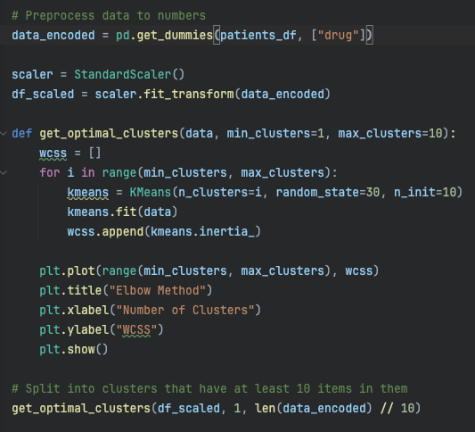
Optimal cluster size (Elbow Method - Code)
Since we will be using the kmean algorithm to cluster our data to learn from it, we need to find a proper cluster size.
We’ll be using the Elbow Method.
This is an method for finding the best cluster size on unsupervised learning.
Since we don’t know what clusters may be relevant this will help guide us.
Multiple drugs, alongside gender and condition makes this an unsupervised learning method due to us not knowing what clusters exist.
Since our data is small the max cluster size allotted was data divided by 10.
This means we will test every cluster size from 1 to at most the amount of clusters needed for a cluster to have no less than 10 data points.
Anything smaller may make the data too separated and thus reduce correlation.

Slide 10
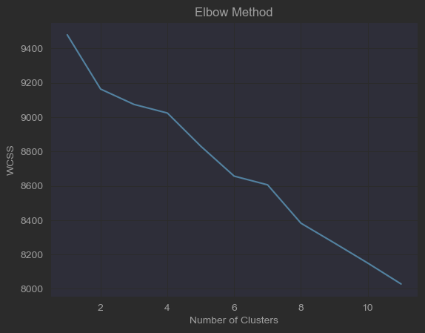
Optimal cluster size (Elbow Method - results)
The chart shows the number of cluster (x-axis) and WCSS (y-axis)
WCSS (Within-Cluster Sum of Squares): A way to measure how spread out data points are inside each cluster.
Lower is better
According to the graph having a larger cluster size will be more beneficial as the points will be less spread out.
WARNING: though 10 clusters shows a lower WCSS than say 2 or 3, it is worthwhile to analyze the clusters to make sure the groups look valid.

Slide 11
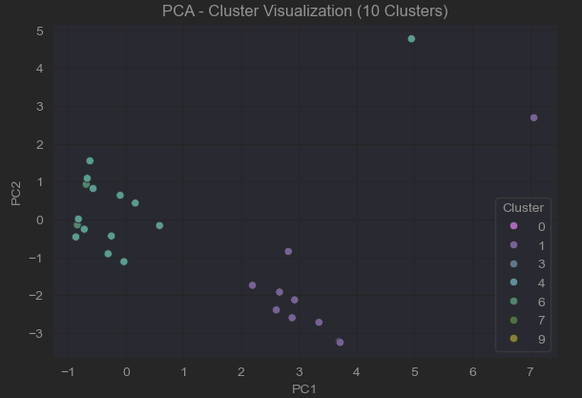
Optimal cluster size (Elbow Method - results Continued)
When plotted the chart does not appear to show 10 different clusters.
Visually the chart show 3-5 clusters.
We will try manually checking clusters for smaller sizes to see if visually they make more sense.

Slide 12
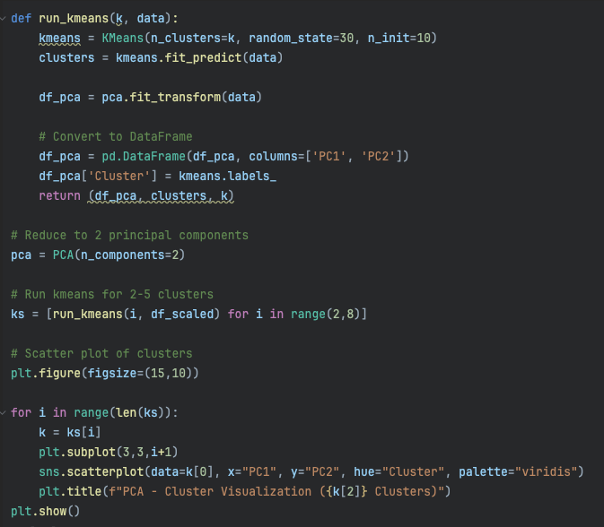
Optimal Cluster Size (Manual - Code)
We created a function to run k-means for any k size we pass in and that will return a dataframe for the data reduced to 2 principal components.
We then called this function 6 times, starting at cluster size 2 and ending at cluster size 7 (for i in range(2,8))
The data is then plotted on 6 scatterplots to compare.

Slide 13
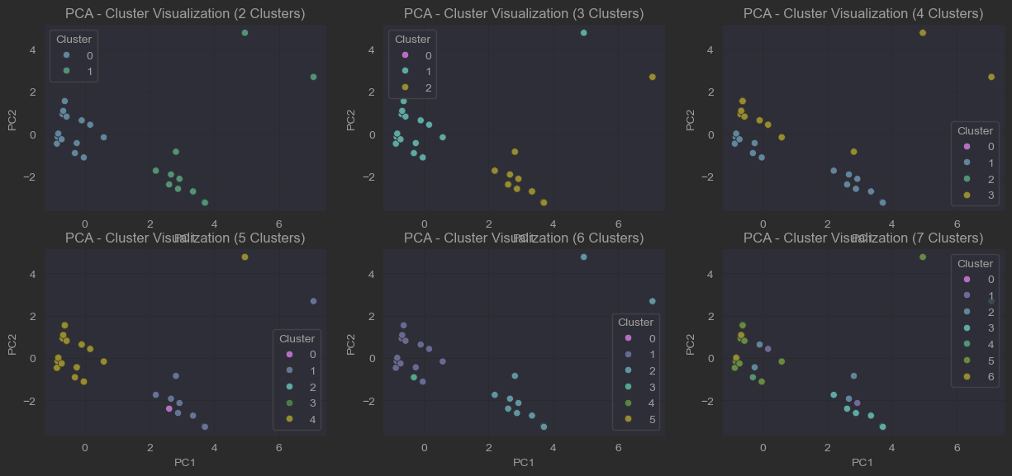
Optimal Cluster Size (Manual - Results)

Slide 14
Optimal Cluster Size (Manual - Results Continued)
Visually the charts with a higher cluster size do not show any congruent cluster groups.
Most the groups cluster around 2 main clusters
2 clusters show well defined areas with only 2 outliers (top right corner)
Adding more than 2 clusters should in theory improve the cluster groups and give more clear defining spaces.
The interesting aspect is that on clusters of 3-7, the expectation would be that that middle left group would split into new smaller clusters, which it does not.
The most reasonable explanation is that this group of data points are very correlated.
They stay within their group consistently which makes them more robust to change leading to a higher chance of strong correlation and of them being a homogeneous group.
This leads to the belief that a cluster of 2 is the most logical since higher clusters do not create robust groups and just “force split” the group in order to fit into the higher dimensional split.

Slide 15
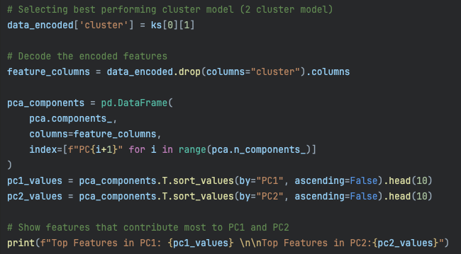
Exploring clusters (code)
In order to understand what the clusters represent we will print the top 10 features that impact each principal component.
First we need to decode the encoded drug columns.

Slide 16
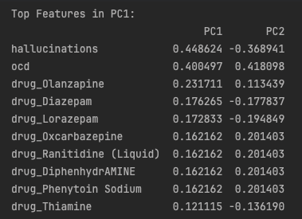
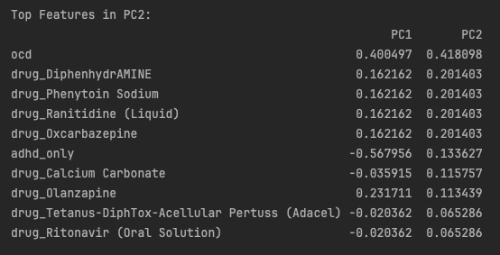
Exploring clusters (components)
In order to understand what the clusters represent we will print the top 10 features that impact each principal component.
The most common contributing factors to PC1 are hallucinations & ocd.
Since these are the conditions we are testing on this is expected.
We can look further down to see the next most features are drugs.
The same holds for PC2, after the primary component we are testing on, the most common are drugs.

Slide 17
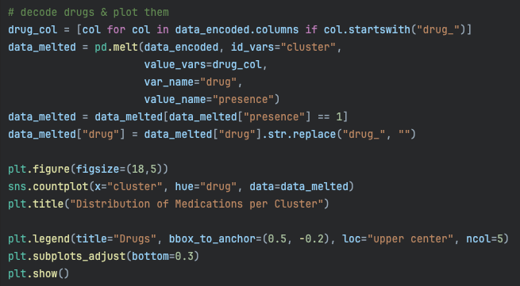
Medication Distribution per cluster (code)
To analyze the drugs further, we can look at a distribution of the drugs per cluster.
The code here shows how to set that up alongside moving the legend to the bottom since it includes a lot of drugs.

Slide 18
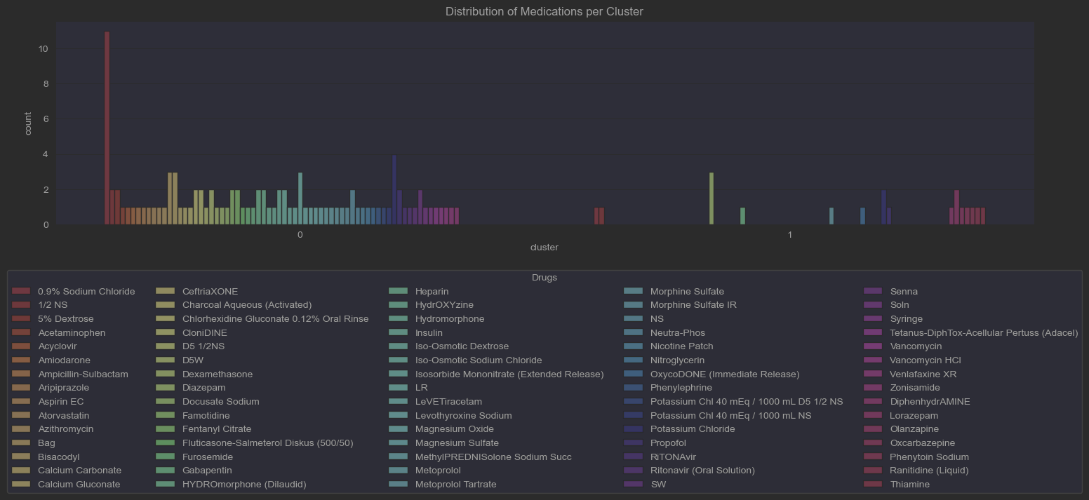
Medication Distribution per cluster (chart explained)
The chart shows the most common drugs for each cluster.
Cluster 0 shows a high amount of different drugs when compared to cluster 1
This leads to the assumption that the clusters are heavily correlated on drugs prescribed over other things such as gender.

Slide 19
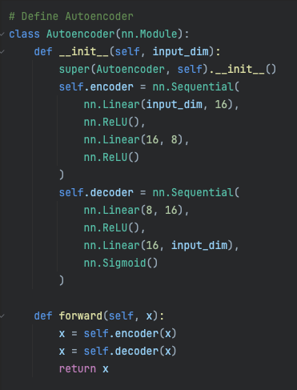
AutoEncoder model
Lastly we will run the data through an auto encoder model which we will define on the right.
This is a very basic model with an encoder and decoder of 4 layers each
8 layers total
Keeping a small model to prevent overfitting our data since its already small.

Slide 20
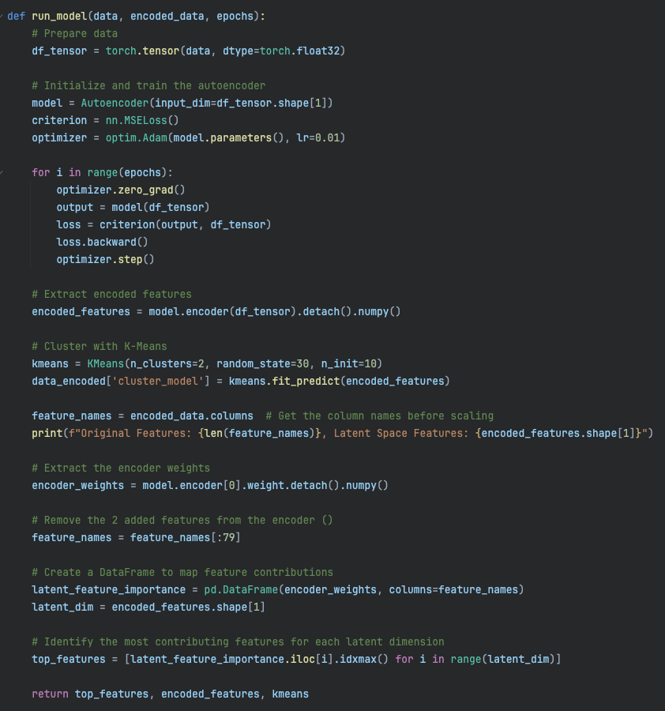
AutoEncoder training
Our model’s run function will train the model using:
Adam as the optimizer
MSELoss
2 clusters as we saw before
Our function will do some clean up of added columns and return:
Top features
Encoded features
kmeans

Slide 21
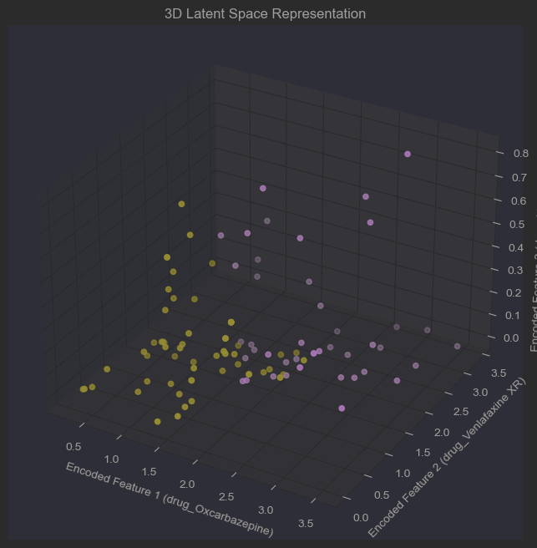
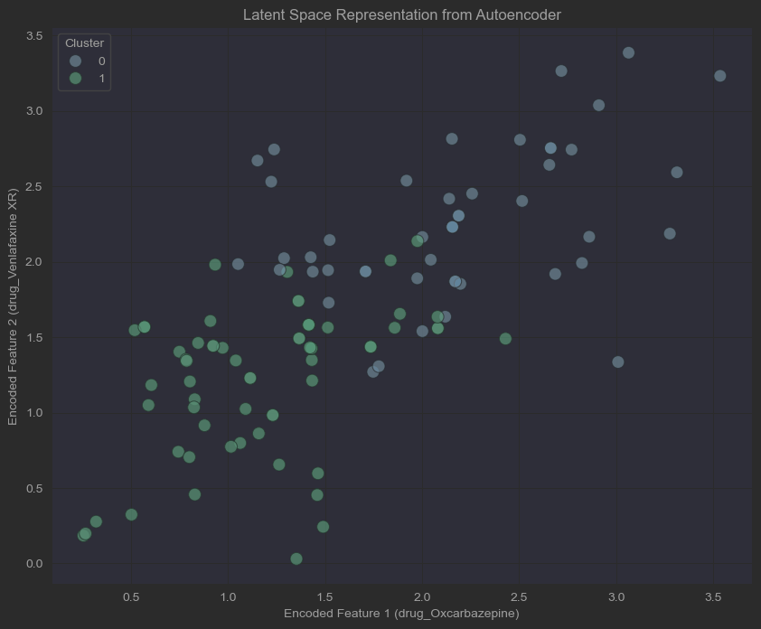
AutoEncoder Latent Space Plots

Slide 22
AutoEncoder Latent Space Plots (explained)
2D
The plot shows 2 cluster groups in a lower dimension and shows each data point (patient) with a correlation between 2 different drugs:
Venlafaxine XR
Oxcarbazepine
This appears to show a stronger correlation between the 2 drugs in regard to hallucinations, adhd, and OCD the higher those features were represented.
3D
The plot in 3D gives us a depth dimension that gives a 3rd feature being of importance when correlating the likelihood of hallucination, adhd and OCD in patients.
2 clear groups are still formed, showing that even with an added dimension the top 2 drugs still shown the highest correlation between the conditions from above.

Slide 23
Conclusion
Prescribed medication shows potential correlation between hallucination, OCD and ADHD.
Disclaimers:
The dataset is small, meaning the data may not show a true accurate representation of the entire population
Drugs may have correlation due to being prescribed to treat hallucination and OCD and not be a cause for developing those conditions
Further analysis can be done to separate cause and effect with the addition of:
Time on medication
Date medication was prescribed vs date hallucinations/OCD were reported.
More data

